Slide 1



NAME-KUNDAN KHARATARAM KUMAWAT
CAPSTONE PROJECT FOR TABLEAU
TOPIC - E-COMMERCE SALES

Slide 2
Problem dataset source is given below.
2. Given data is of E-Commerce Sales.
3. In given data source contain of 21 parameters(column) and 51,290 observations(rows or records).
4. The aim of this project is to analyze the E-Commerce sales.
5.Dataset has following parameters
Order ID, Order Date, Ship Date, Aging, Ship Mode, Product Category, Product, Sales, Quantity, Discount, Profit, Shipping Cost, Order Priority, Customer ID, Customer Name, Segment, City, State, Country, Region, Months .
DATASET SOURCE- https://www.kaggle.com/shashwatwork/ecommerce-data

Slide 3
PROBLEM STATEMENTS
Find which country has highest sales.
2. Find top product based on profit and sales in April .
3. Find top segment of our customer.
Find in which month our target sales was not achieved (average of sales) in critical
parameter order of priority.
5. Find which product category offered highest discount.
6. Find which product quantity was sold most.
7. Find highest shipping cost based on month.
DATASET SOURCE- https://www.kaggle.com/shashwatwork/ecommerce-data

Slide 4
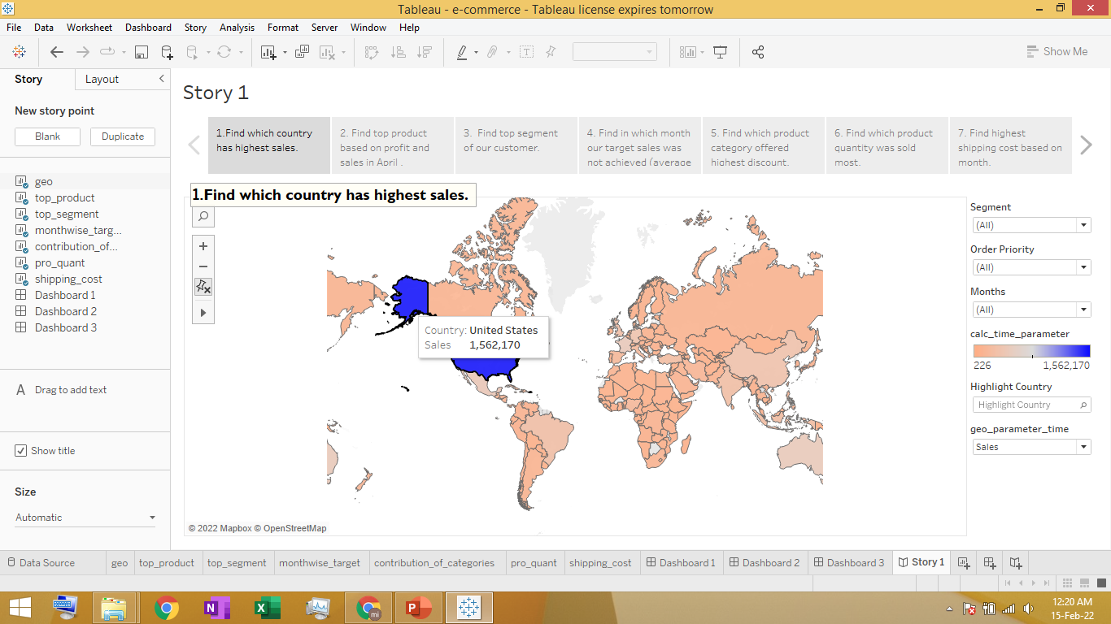
1. Find which country has highest sales.
From above chart we can see that united sates has the highest sales.

Slide 5
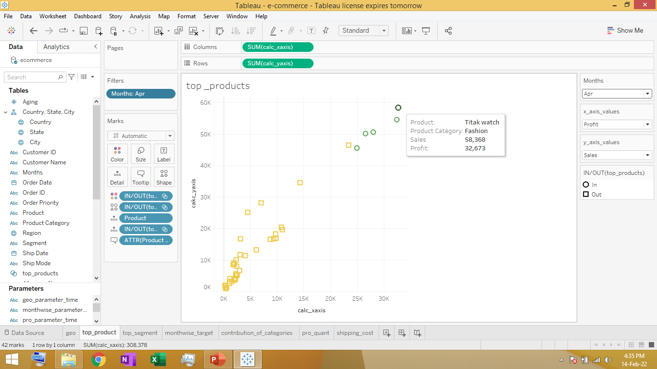
2. Find top product based on profit and sales in April .
Based on above chart we can see that top product is Titak watch in April , when comparing with respect to sales and profit.

Slide 6
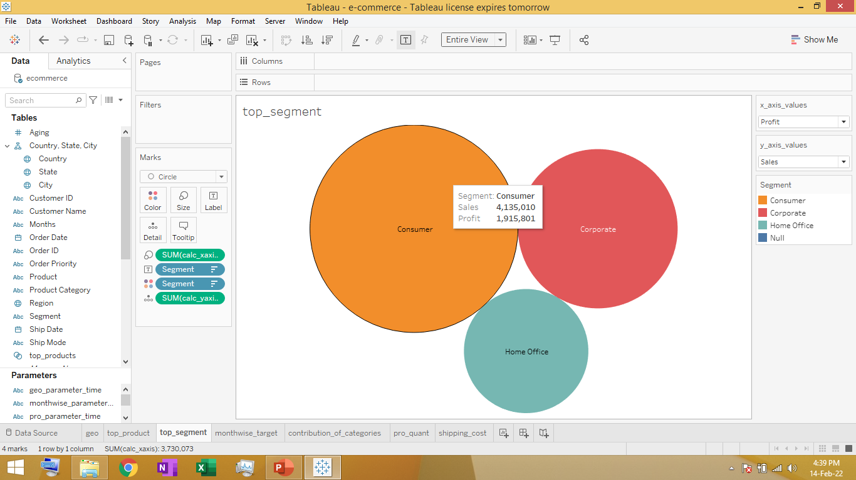
3. Find top segment of our customer.
1.Consumer is the top segment in terms of sales.

Slide 7
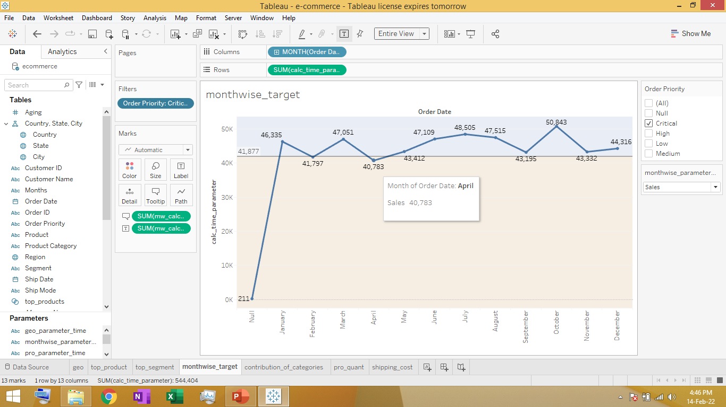
4. Find in which month our target sales was not achieved (average of sales) in critical parameter order of priority.
1. In February and April , month target of sales was not achieved .

Slide 8
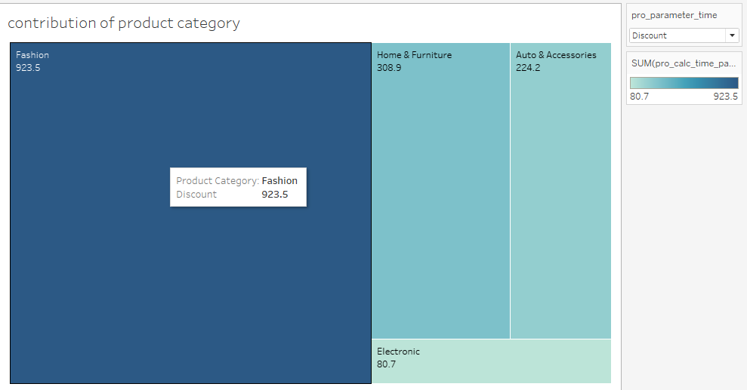
5. Find which product category offered highest discount.
1. Fashion product category provided the highest discount.

Slide 9
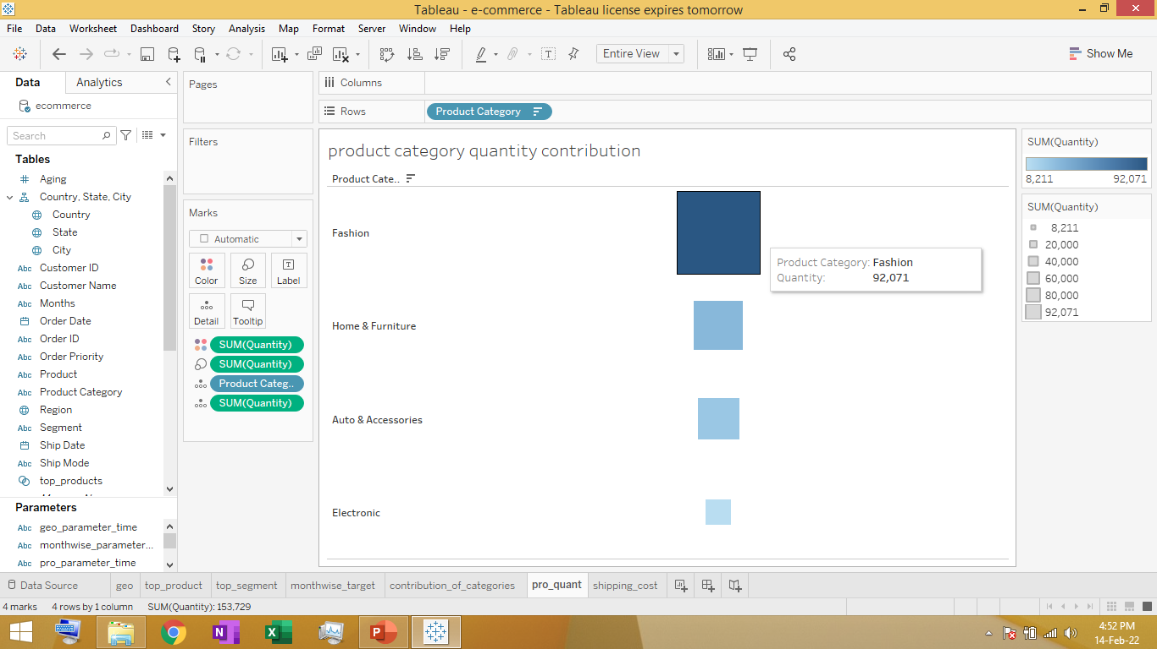
6. Find which product quantity was sold most. .
1. Product category fashion in quantity was sold most.

Slide 10
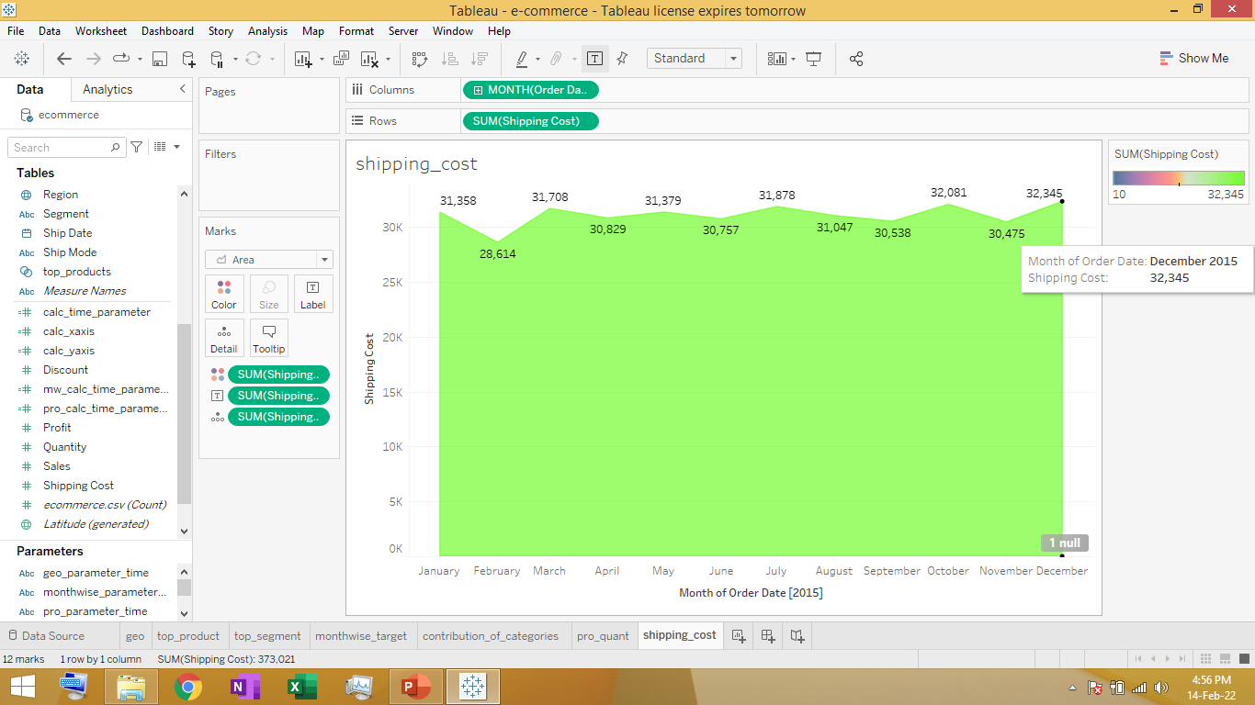
7. Find highest shipping cost based on month
From above graph we can see December month has highest shipping cost (32345) .

Slide 11
CONCLUSION & inference -
United states has highest sales but in other countries it has stark difference in terms of economy. So increase promotions and other offer schemes to increase sales .
Top products based on profit and sales are Titat watch ,T-shirts , running shoes, formal shoes,etc which all comes under fashion product category. It is top performer.
Consumer segment is highest followed by corporate and home office so we need to have new future products introduced based on this criteria of importance.
February is month where sales is least and can’t follow the sales target so need to reduce inventory to decrease cost or have some marketing schemes like offers to increase sales.
Fashion product category offer highest discount , have highest quantity sold and makes most profit and sales, so we have fashion category as most successful category. Study it’s strategy and apply it to improve others.
Based on trends December has highest shipping cost and February the least ,average cost of shipping lies between 28500 to 32500 dollars .

Slide 12
EXECUTIVE SUMMARY -
United states has highest sales but in other countries it has stark difference in terms of economy. So increase promotions and other offer schemes to increase sales .
Fashion product category offer highest discount , have highest quantity sold and makes most profit and sales, so we have fashion category as most successful category. Study it’s strategy and apply it to improve others.
Consumer segment is highest followed by corporate and home office so we need to have new future products introduced based on this criteria of importance.
February is month where sales is least and can’t follow the sales target so need to reduce inventory to decrease cost or have some marketing schemes like offers to increase sales.
Based on trends December has highest shipping cost and February the least ,average cost of shipping lies between 28500 to 32500 dollars .
VIDEO LINK-https://drive.google.com/file/d/1pIEDxNjjvobgnq9BHtFv7KfOQWtDIs33/view?usp=sharing
RESOURCES-https://drive.google.com/drive/folders/1IDhSD1nTSiK47Aq3VvKRWwdkndO5mdyy?usp=sharing

